Slide 1


CYBERSECURITY IN NETWORKS AND INTRUSION DETECTION SYSTEMS (IDS)
Pablo Domínguez - Nº 1707282

Slide 2
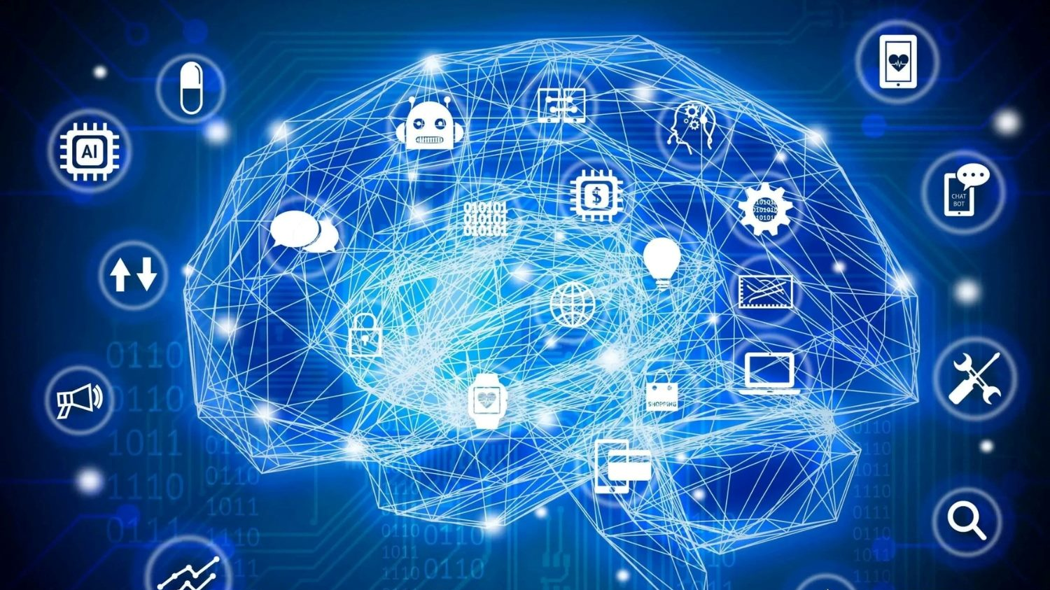
MACHINE LEARNING

Slide 3
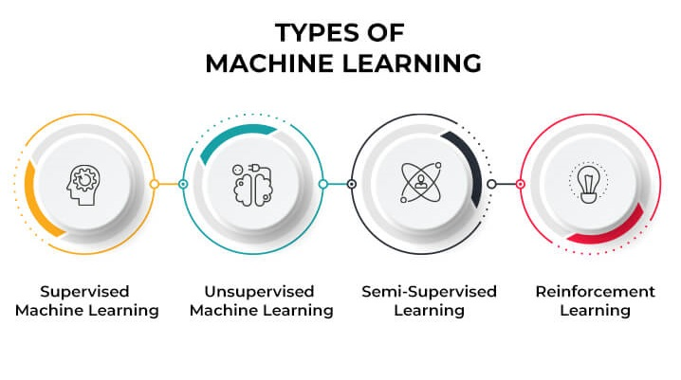

Slide 4
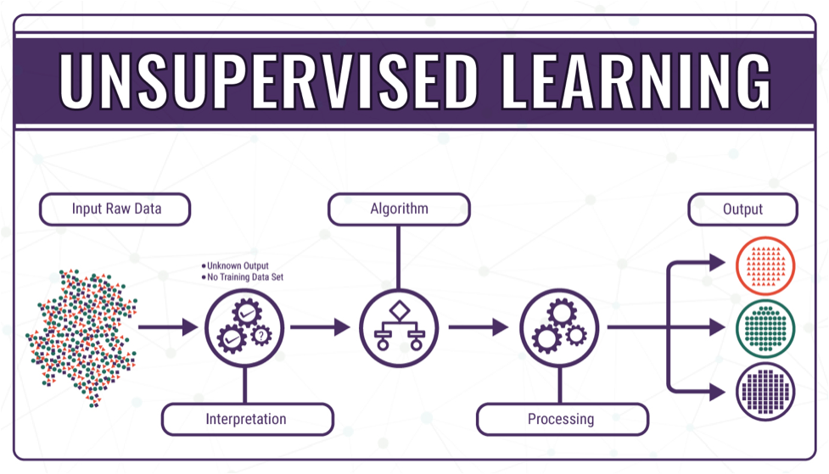

Slide 5
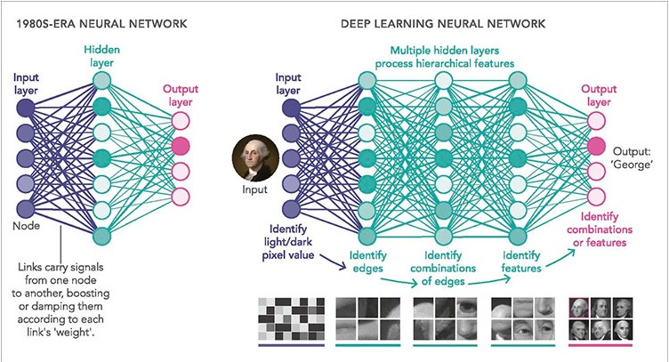
Deep learning

Slide 6
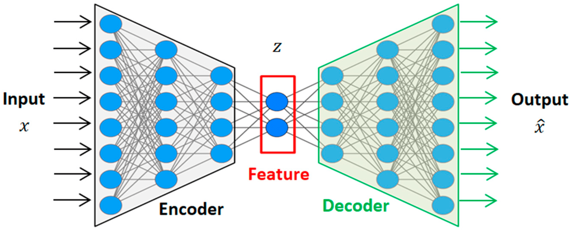
Autoencoder

Slide 7

Privacy Enhancing Techniques Exploration

Slide 8
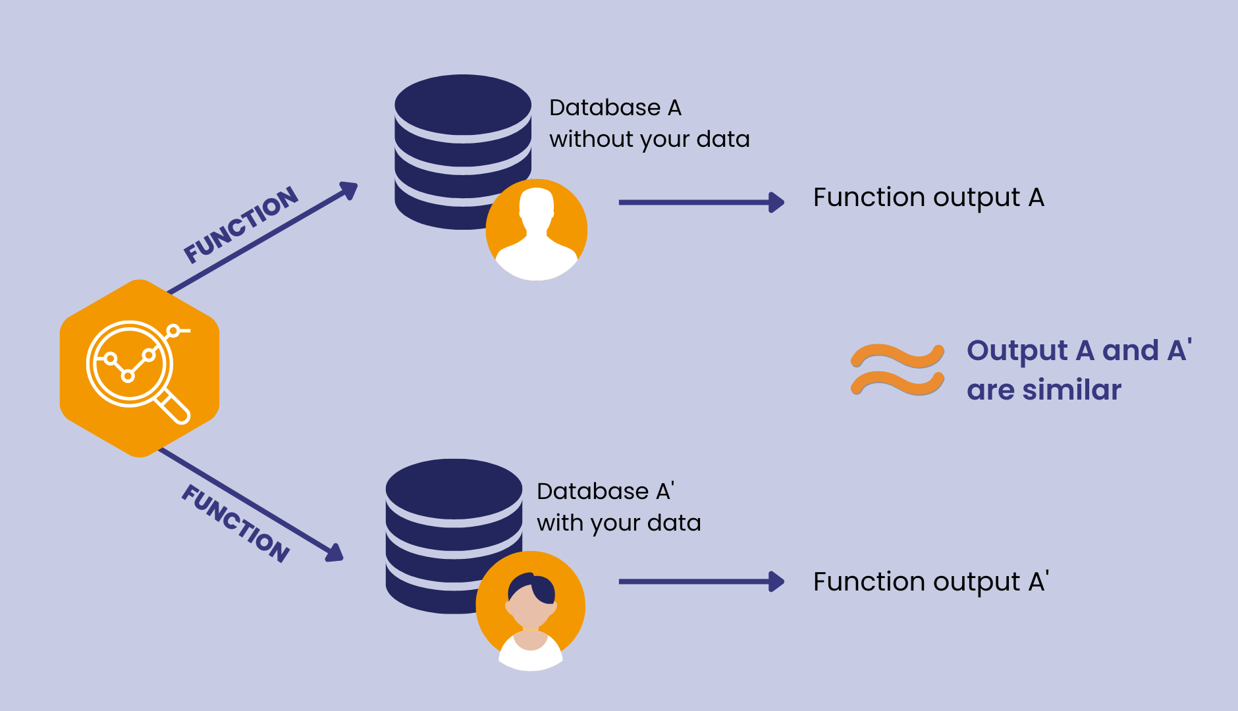
Differential Privacy

Slide 9
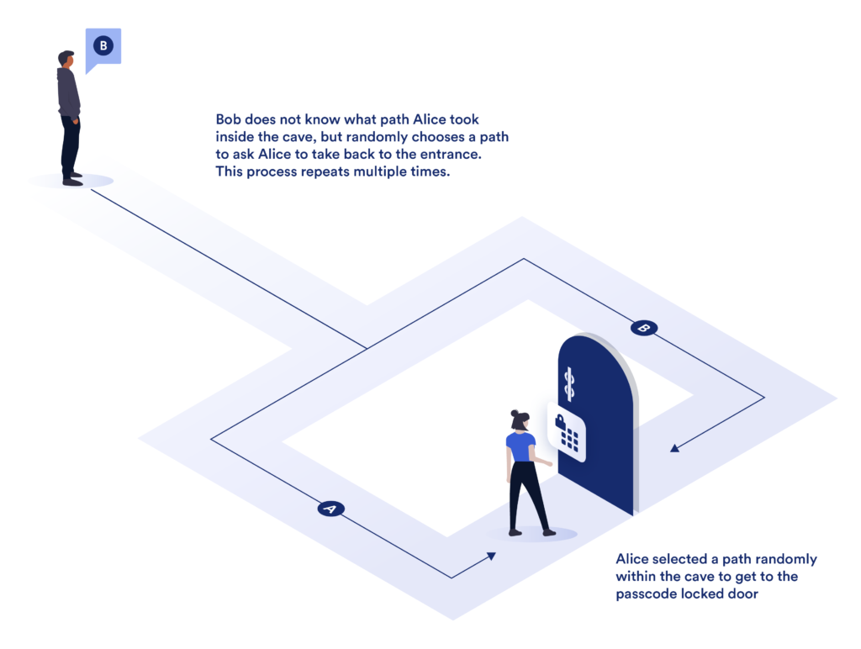
ZKP - Zero-Knowledge Proofs

Slide 10
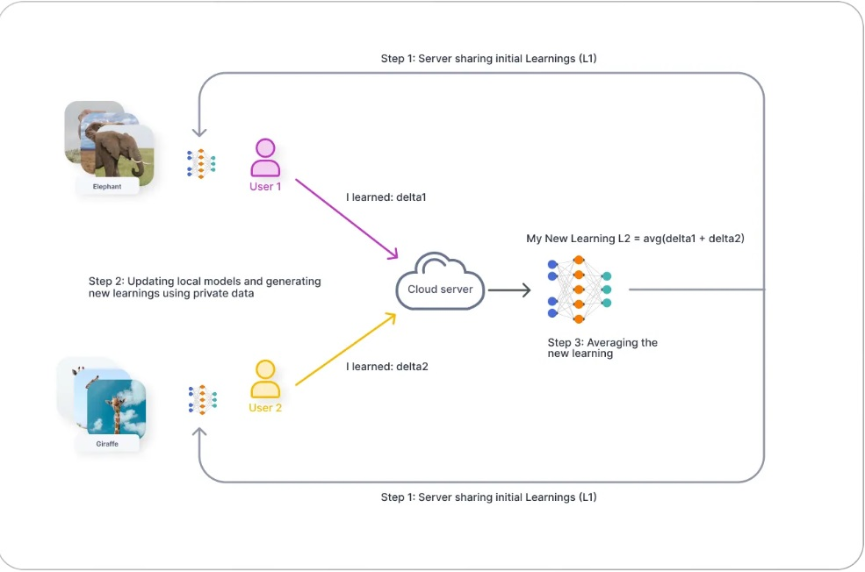
Federated Learning

Slide 11
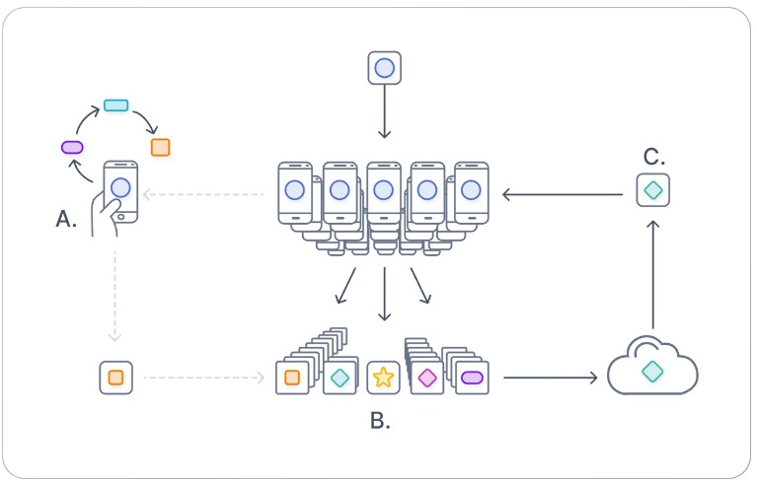
How Federated Learning Works?

Slide 12

Implementation

Slide 13




Slide 14


Tools

Slide 15

Issues and Challenges during internship

Slide 16

FIM

